Slide 1
AN EYE FOR AN EYE MAKES THE WORLD GOES BLIND
(Conflict Management)
Tiong Hui, Bryan, AiXin

Slide 2
Scenario 2
Son and parents shout at each other a lot.
Parents don’t like son to stay out too late
Son is not allowed to go friends party
situation becomes tense

Slide 3

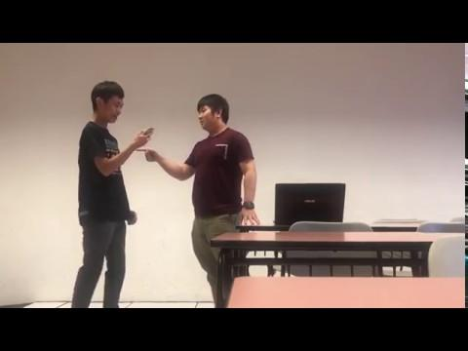
Negative Example

Slide 4

Expressed Struggle
Shouting at each other
How the conversation started
Lead to misunderstanding
Can be taken personnel
Openly disagreeing with each other
Turns question into an argument
Saying NO no matter what
Never ending

Slide 5
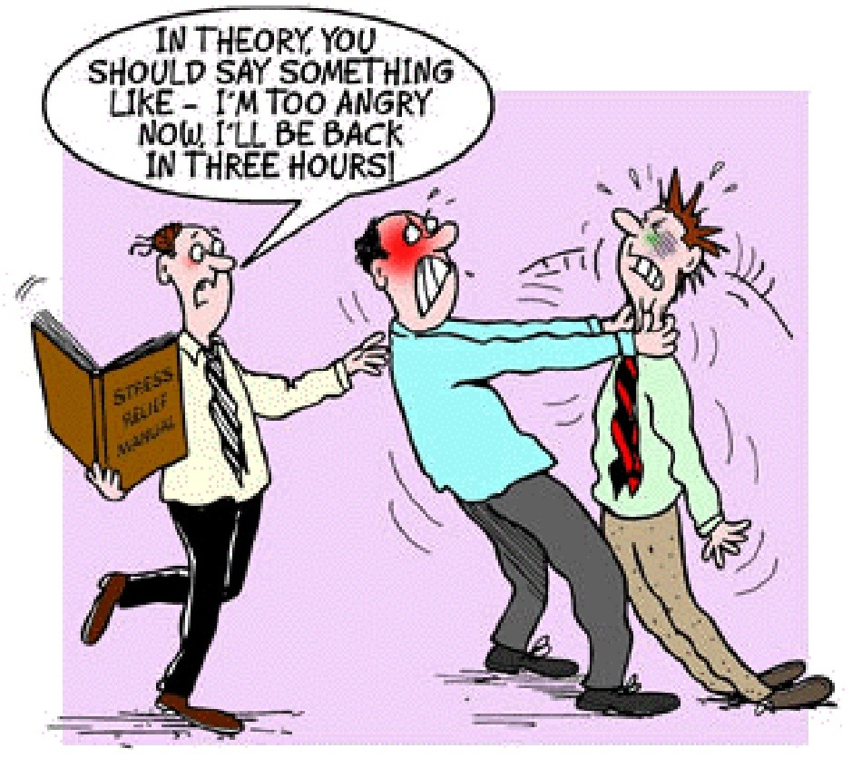
Perceive incompatible goals
Perceive incompatible goals :
  PARENTS
        Want to protect their child
        Overprotective to the point of
        being a control freak
  CHILDREN
        Wants to have some freedom
        Wants to be treated as a young adult
        Wants to hang out with friends

Slide 6
Interference & Interdependence
PARENTS
        Doesn’t allow child to hang out
        Still thinks their child is not mature yet
        Doesn’t listen to child’s ideas / feelings
        Parents have more power than child
CHILDREN
        He was selfish, only thinks about himself

Slide 7
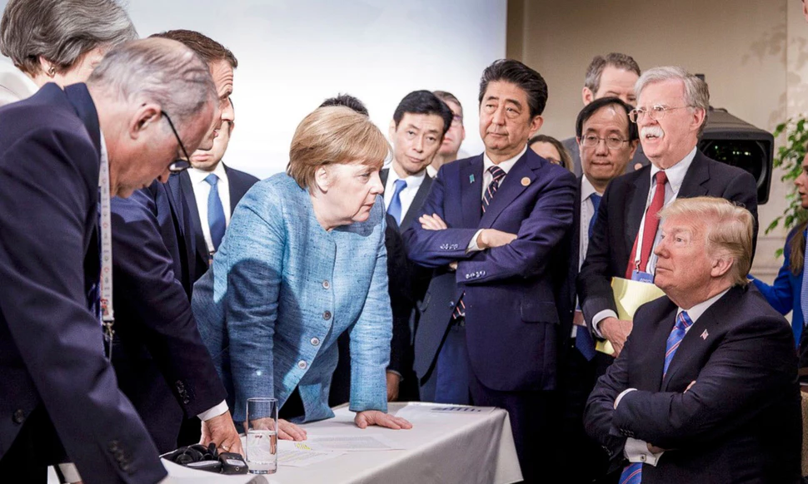
Unsuitable Body language
Parents
  Slapping his son
  Dad pulling his son’s ear
  Folding his arms
Son
  Pointing his middle finger
  Swinging dad’s arm away

Slide 8

Inappropriate statements
Parents
  -parents judge their friends
  Using threatening statements
Son
  Talk back to parents
  Using loud voice / high tone
  Usage of vulgarities

Slide 9
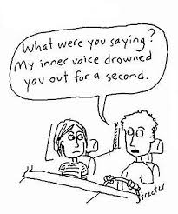
Ineffective listening skills
Parents
  Interrupting his child when he was talking
  No eye contact
  Have a close mind
  Both should not talk at the same time
Son
  Using phone
  Fidgeting around

Slide 10

Lack of Empathy
Parents
  Lack of trust
  Lack of understanding
Child
  Lack of consideration

Slide 11

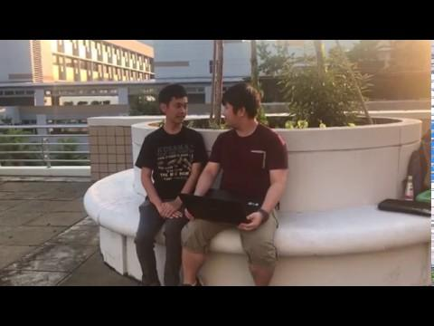
Positive Example

Slide 12
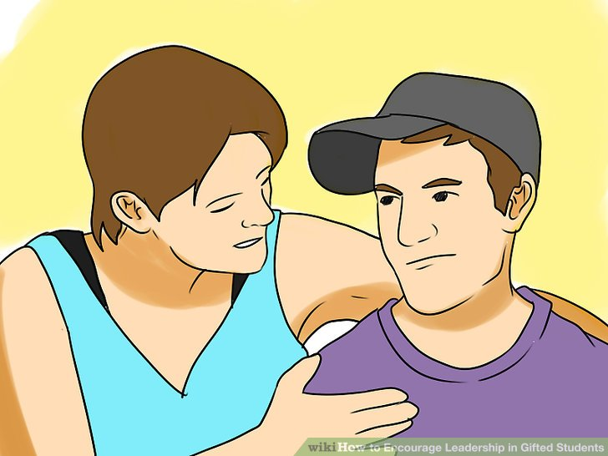
Types of effective verbal & non-verbal communication
Effective Verbal Communication
Questions
    Where is the party place ?
    Who are you going with ?
Encouraging statements

Slide 13
Types of effective verbal & non-verbal communication
Body Language
Have an open posture
    Arms by the sides
Relaxed and open facial expression

Slide 14
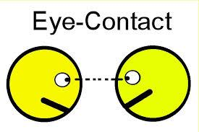
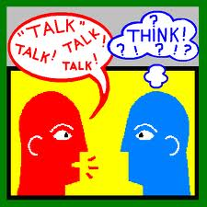
Good listening techniques
Eye Contact
One person speaks at a time

Slide 15
Demonstrate Empathy
Child should apologize if he/she came home late and explain to parents
Parents should question the child

Slide 16

Conflict Handling Style
Compromise

Slide 17
Conclusion
Communication
Compromise
Collaborate

